Slide 2
Absence of Copyright
This slideshow contains photos, diagrams, and information, some of which were attained through internet searches of public websites. The author of this presentation does not own the copyright on this information, so this slideshow is for personal use only—not for sale or profit. Please utilize it to seek the Lord and grow in your knowledge of His Word and ways.

Slide 4
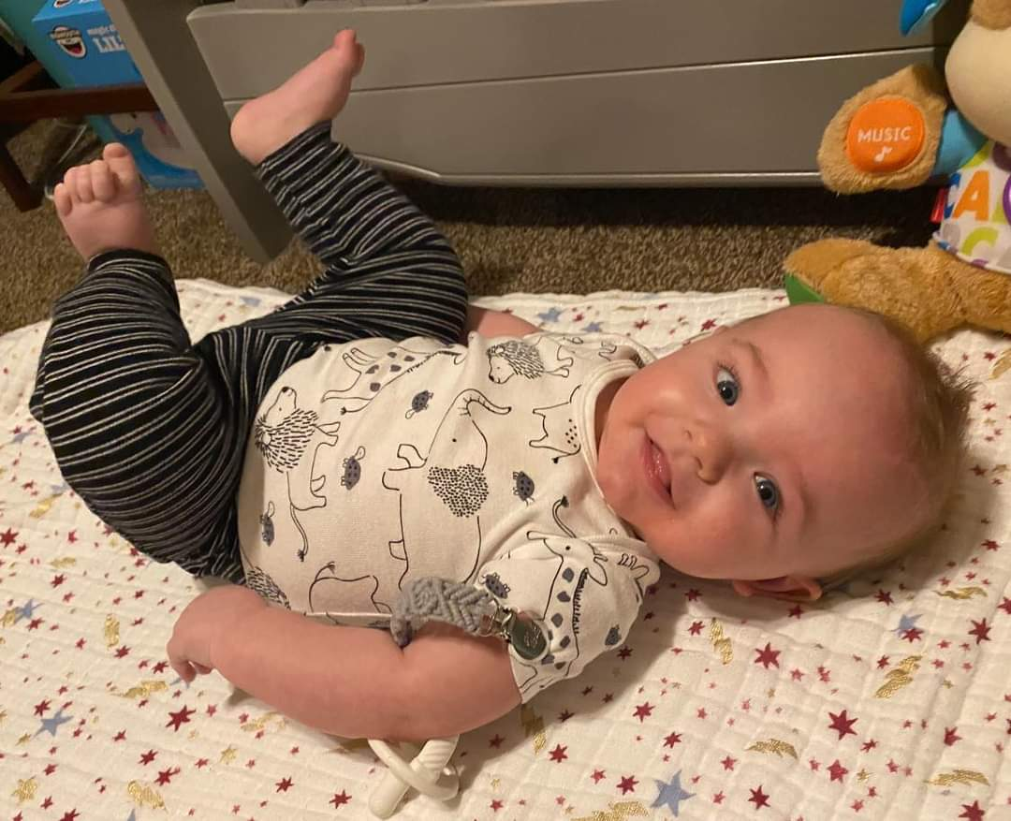
Why are you guys sideways?

Slide 5
Prayer and Announcements
Sunday: 9:15 Fellowship
9:30 SS Master Class
10:30 Worship
Revelation Study available on our church website
www.faithprinceton.org
Email questions and comments to
pastor@faithprinceton.org

Slide 7
END HERE August 26, 2020
LAST WEEK 15 Revelation 10
Time to Repent... No more delay!!!
BEGIN HERE SEPTEMBER 2, 2020
WEEK 16 Revelation 11
Notes:
After the sixth seal has been opened (Revelation 6)...
The 144,000 are sealed with the seal of the Living (Loving) God... To mark ownership, protection, and loyalty
In Rev 7:9ff we will hear about a multitude of believers in heaven!

Slide 8
Revelation 11
Measuring the Temple
The Two Witnesses
The Last Trumpet
The Rise of the Beast
Notes:
Newport, Lion and Lamb, 214.
G. Beasley-Murray notes that by means of the interlude in chapters 10 and 11, John wishes to make two points completely clear. The first point answers the perennial question of the martyrs, “How long will we have to suffer?” (10:7). The second point answers a question not yet raised in the visions, “What is the task of the church in these troublesome times?” (11:1-13).

Slide 9
Revelation 11:1-2 Measuring the Temple
1 Then there was given me a measuring rod like a staff; and someone said, “Get up and measure the temple of God and the altar, and those who worship in it. 2 Leave out the court which is outside the temple and do not measure it, for it has been given to the nations; and they will tread under foot the holy city for forty-two months.
Notes:
1 measure the temple of God and the altar, and those who worship in it.
Different viewpoints.... =➔

Slide 10
Revelation 11:1-2 Measuring the Temple
Possible Interpretations:
Dispensational view: Jewish Temple in Jerusalem rebuilt, and ritual worship re-established for 3 and a half years, but war is rampant... False peace agreement with Antichrist.
Jewish salvation emphasis: G. Ladd sees this as an indication that Jewish Israel will become part of spiritual Israel.
Christian church emphasis: use of language of Jewish prophecy to the whole Christian community. Christian Church is spiritually protected, even as the rest of the world is at war.
Notes:
1 measure the temple of God and the altar, and those who worship in it.
Literal Jewish Temple? OR Representation of the Christian Church?
2 holy city = literal Jerusalem? OR the church?
IMPORTANT NOTE: Jerusalem and the Temple had been destroyed in 70 AD, about 20 – 25 years before Revelation had been written. If either refers to a literal temple and city, they would have to be rebuilt before this time.
2 Leave out the court which is outside the temple and do not measure it, for it has been given to the nations; and they will tread under foot the holy city for forty-two months.
1,260 days (vs 3) = 42 months (vs 2) = 3 ½ years
NOTE: SEE DANIEL 7 – 12!! Daniel 7:25; 12:7 = “a time, times, and half a time”
Limited amount of time
Tread under foot = could be a reference to physical destruction or spiritual defilement and apostasy?

Slide 11
Revelation 11:3-6 The Two Witnesses
3 And I will grant authority to my two witnesses, and they will prophesy for twelve hundred and sixty days, clothed in sackcloth.” 4 These are the two olive trees and the two lampstands that stand before the Lord of the earth. 5 And if anyone wants to harm them, fire flows out of their mouth and devours their enemies; so if anyone wants to harm them, he must be killed in this way. 6 These have the power to shut up the sky, so that rain will not fall during the days of their prophesying; and they have power over the waters to turn them into blood, and to strike the earth with every plague, as often as they desire.
Notes:
3 And I will grant authority = Again shows God is in control !!!
to my two witnesses..., 4 These are the two olive trees and the two lampstands that stand before the Lord of the earth.
TWO OLIVE TREES Zechariah 4:3 Newport: “the channels through which God supplies His power for work to be done... “ Zech 4:6 “This is the word of the Lord to Zerubbabel saying, ‘Not by might nor by power, but by My Spirit,’ says the Lord of hosts.”
Zech 4:14 “These (the olive trees) are the two anointed ones who are stading by the Lord of the whole earth.”
Zech 2 measuring the Temple. Zech 3 Joshua the High Priest in soiled clothing
and they will prophesy for twelve hundred and sixty days, clothed in sackcloth.”
1,260 days = 42 months (vs 2) = 3 ½ years
Sackcloth = indication of judgment; need for repentance; humility
5 And if anyone wants to harm them, fire flows out of their mouth and devours their enemies; so if anyone wants to harm them, he must be killed in this way. 6 These have the power to shut up the sky, so that rain will not fall during the days of their prophesying; and they have power over the waters to turn them into blood, and to strike the earth with every plague, as often as they desire.
Morris, Tyndale
5-6 The extraordinary power of the witnessing church is set forth in terms reminiscent of Elijah and Moses. ➔

Slide 12
Revelation 11:3-6 The Two Witnesses
Elijah
Called down fire from the sky (1 Kings 18 on Mt. Carmel; 2 Kings 1:10-11 when army tried to arrest him)
Prevented rain from falling (1 Kings 17:1ff; See also James 5:16-18)
Moses
Water into blood and every plague (Exodus 7-12)
Notes:
5 And if anyone wants to harm them, fire flows out of their mouth and devours their enemies; so if anyone wants to harm them, he must be killed in this way. 6 These have the power to shut up the sky, so that rain will not fall during the days of their prophesying; and they have power over the waters to turn them into blood, and to strike the earth with every plague, as often as they desire.
Morris, Tyndale
5-6 The extraordinary power of the witnessing church is set forth in terms reminiscent of Elijah and Moses.
(Elijah) The destroying fire recalls 2 Ki. 1:10-11 (also 1 Kings 18 on Mount Carmel); the ability to prevent rain 1 Ki. 17:1;
James 5:16-18 ¹⁶ Therefore, confess your sins to one another, and pray for one another so that you may be healed. The effective prayer of a righteous man can accomplish much. ¹⁷ Elijah was a man with a nature like ours, and he prayed earnestly that it would not rain, and it did not rain on the earth for three years and six months. ¹⁸ Then he prayed again, and the sky poured rain and the earth produced its fruit.
(Moses) the turning of waters into blood and striking of earth with every kind of plague Ex. 7-12.
THE LAW AND THE PROPHETS !!!

Slide 13
Revelation 11:7-10 The Beast Makes War...
7 When they have finished their testimony, the beast that comes up out of the abyss will make war with them, and overcome them and kill them. 8 And their dead bodies will lie in the street of the great city which mystically is called Sodom and Egypt, where also their Lord was crucified...
Finished their testimony = God’s timing
Make war with them
The Great City
Notes:
Morris, Tyndale
7 Here is the first mention in Revelation of the beast that comes up from the Abyss. He is spoken of as well known, but fuller descriptions of him occur in chs. 13 and 17. Observe the similarity of language in 13:7 to describe the warfare of the beast against the church. For Abyss see on 9:1.
Finished their testimony = God’s timing
Make war with them
The Great City
The Beast = see Daniel 7
The Cities of Man and Wickedness in Revelation: Sodom, Egypt, Jerusalem, Rome, Babylon

Slide 14
Revelation 11:7-10 The Beast Makes War
9 Those from the peoples and tribes and tongues and nations will look at their dead bodies for three and a half days, and will not permit their dead bodies to be laid in a tomb. 10 And those who dwell on the earth will rejoice over them and celebrate; and they will send gifts to one another, because these two prophets tormented those who dwell on the earth.
Notes:
Three and a half days = literal or figurative?
Rejoice and Celebrate with gifts = “the Satanic Christmas”
because these two prophets tormented those who dwell on the earth. = told the truth and backed it up with signs and wonders !
Those who dwell on the earth = those not marked for the Lord... (or because church gone?? = raptured??)

Slide 15
Revelation 11:11-13 Risen Witnesses
11 But after the three and a half days, the breath of life from God came into them, and they stood on their feet; and great fear fell upon those who were watching them.
12 And they heard a loud voice from heaven saying to them, “Come up here.” Then they went up into heaven in the cloud, and their enemies watched them. 13 And in that hour there was a great earthquake, and a tenth of the city fell; seven thousand people were killed in the earthquake, and the rest were terrified and gave glory to the God of heaven.
Notes:
11 the breath of life from God came into them, and they stood on their feet; = Ezekiel’s dry bones coming to life
and great fear fell upon those who were watching them.
12 And they heard a loud voice from heaven saying to them, “Come up here.” Then they went up into heaven in the cloud, and their enemies watched them.
13 And in that hour there was a great earthquake, and a tenth of the city fell; seven thousand people were killed in the earthquake,
Frequent prophesy about earthquake at the end
and the rest were terrified and gave glory to the God of heaven. = Repentance???

Slide 16
Revelation 11:14 End of Second Woe
14 The second woe is past; behold, the third woe is coming quickly.

Slide 17
Revelation 11:15ff The Last Trumpet...
15 Then the seventh angel blew his trumpet, and there were loud voices in heaven, saying, “The kingdom of the world has become the kingdom of our Lord and of his Christ, and he shall reign forever and ever.” 16 And the twenty-four elders who sit on their thrones before God fell on their faces and worshiped God, 17 saying,
Notes:
Meanwhile... Back in heaven... Still worship!!!
THE LAST TRUMPET the woe of the seventh trumpet won’t come until the bowl judgments in chapter 16!!!
Revelation 8:2 And I saw the seven angels who stand before God, and seven trumpets were given to them. = Referred to as “the Trumpet Judgments”
? Same as the last trumpet in 1 Corinthians 15:51-52 (see also 1 Thess 4)???
The Seventh Trumpet Revelation 11:15ff. Central idea of Revelation: the establishment of the Kingdom of God!!!
Handel’s Messiah, The Hallelujah Chorus : “The kingdom of the world has become the kingdom of our Lord and of his Christ, and he shall reign forever and ever.”
Revelation 19:6 Hallelujah? For the Lord God Omnipotent reigneth.

Slide 18
Revelation 11:15ff The Last Trumpet
17 saying,
“We give thanks to you, Lord God Almighty, who is and who was, for you have taken your great power and begun to reign. 18 The nations raged, but your wrath came, and the time for the dead to be judged, and for rewarding your servants, the prophets and saints, and those who fear your name, both small and great, and for destroying the destroyers of the earth.”
Notes:
17 saying,
“We give thanks to you, Lord God Almighty, who is and who was, for you have taken your great power and begun to reign.
God is always and has always been sovereign, but there will come a time when He will do away with all who have tried to usurp His power and authority!!!
Satan = the prince of this world, the ruler of the air (along with the Beast and false prophet)
He will reign!!! Accomplished in Return of Christ – Rev 19:11ff
18 The nations raged,
but your wrath came, and the time
for the dead to be judged, and
for rewarding your servants, the prophets and saints, and those who fear your name, both small and great, and
for destroying the destroyers of the earth.”

Slide 19
END HERE SEPTEMBER 2, 2020
LAST WEEK 16 Revelation 11
The Last Trumpet
BEGIN HERE SEPTEMBER 9, 2020
WEEK 17 Revelation 12
Notes:
After the sixth seal has been opened (Revelation 6)...
The 144,000 are sealed with the seal of the Living (Loving) God... To mark ownership, protection, and loyalty
In Rev 7:9ff we will hear about a multitude of believers in heaven!

